Slide 1
Electronic Vital Events Registration System (EVERS)
Social Security Verification Instructions
Home
Next
Table of Contents

Slide 2
Table of Contents
Social Security Verification Instructions
Verify Social Security Instructions
SSN Verification Guidelines
Hours of Operation
Status Codes and Descriptions
Frequently Asked Questions (FAQs)
Alabama Department of Public Health Points of Contact
Home
Previous
Next
Table of Contents

Slide 3
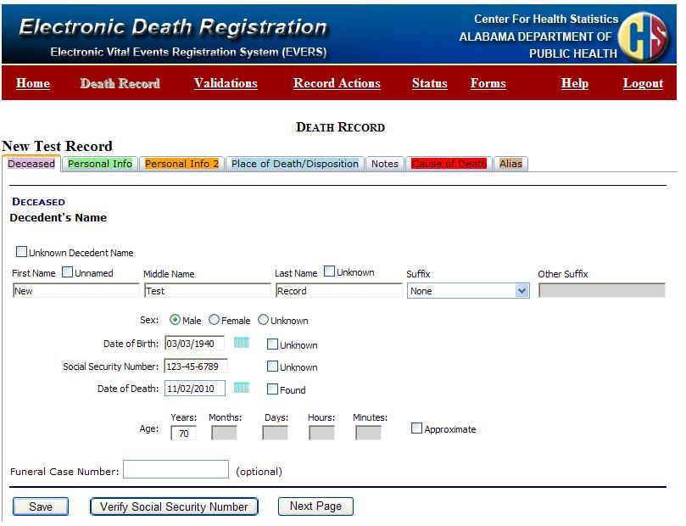
Social Security Number Verification Instructions :
To verify a Social Security Number, select an existing record that has not been signed or create a new record.
On the Deceased Tab, as displayed on the right, review the information to ensure it’s correct.
Before you can verify a record, Social Security requires the following fields:
First Name
Last Name
Sex
Date of Birth
SSN
Home
Previous
Next
Table of Contents

Slide 4
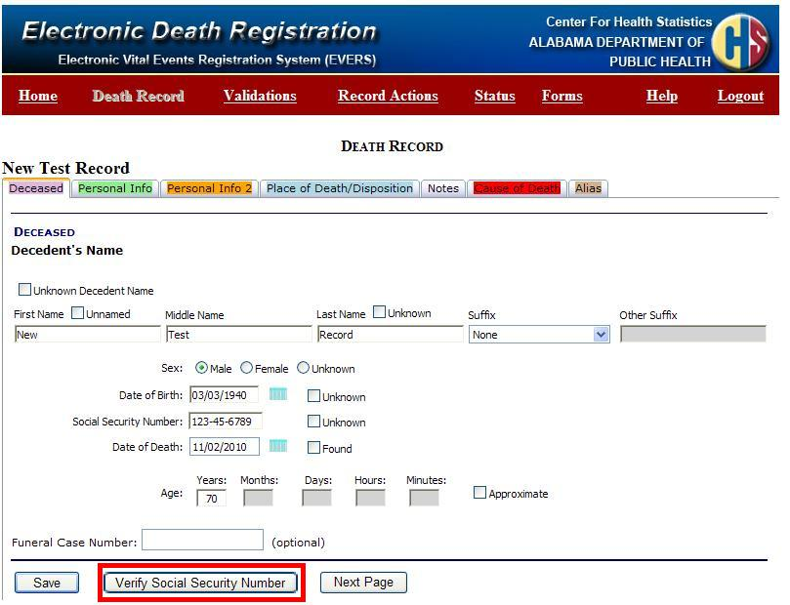
Social Security Number Verification Instructions (continued):
Click “Verify Social Security Number” at the bottom of the Deceased Tab page.
The Social Security Verification Page will open displaying the required SSA fields.
Home
Previous
Next
Table of Contents

Slide 5
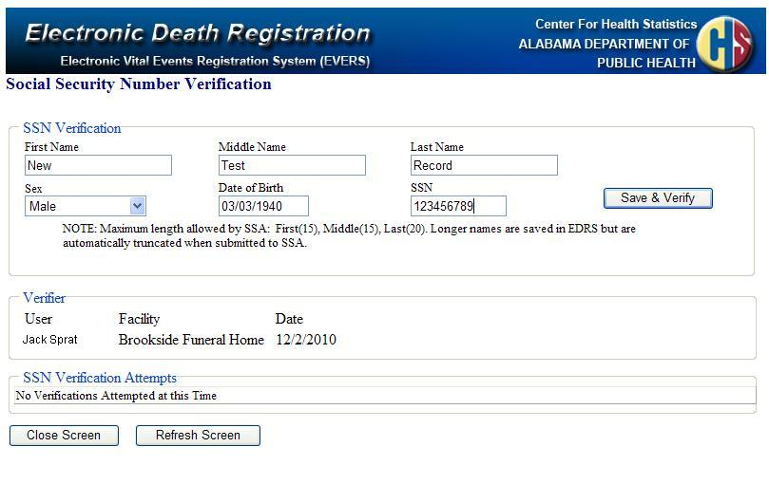
Social Security Number Verification Instructions (continued):
Notice the core information from the Deceased Tab is displayed on the Social Security Number Verification Page.
You may modify information in these fields on the Verification page as well as on the Deceased Tab during the verification process.
Home
Previous
Next
Table of Contents

Slide 6
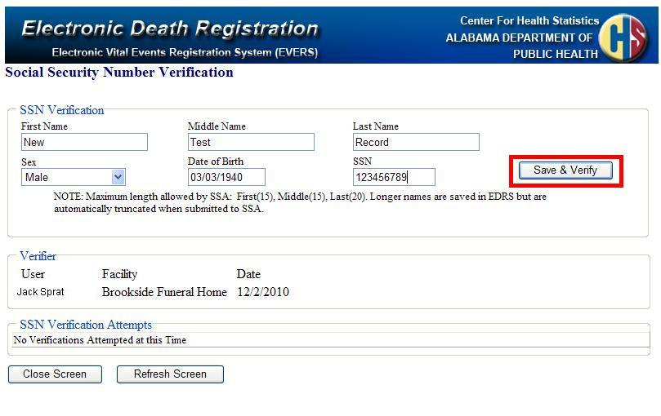
Social Security Number Verification Instructions (continued):
Once you ensure the information in the six fields are accurate, you are ready to Verify the record. Remember only the Middle Name is optional. The remaining five fields are required.
To verify the record with the Social Security Administration, click “Save & Verify”.
After you click “Save and Verify” any changes made to the six fields displayed on this screen will save and the information will be transmitted directly to the Social Security Administration.
Home
Previous
Next
Table of Contents

Slide 7
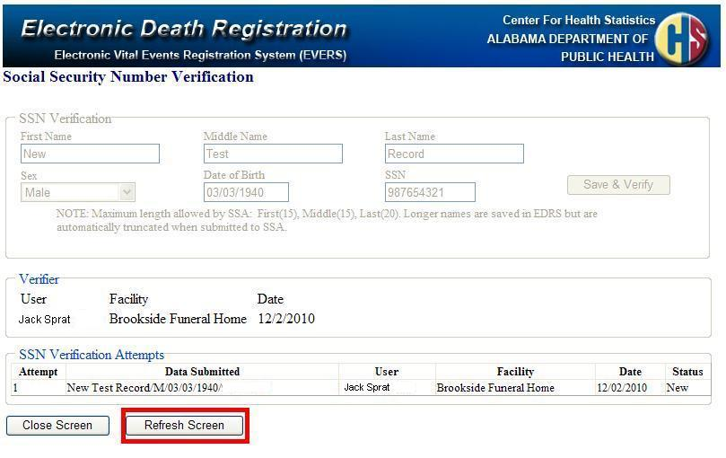
Social Security Number Verification Instructions (continued):
Notice the verification attempt will be displayed in the SSN Verification Attempts grid with “New” usually displaying in the Status column.
To retrieve the response from Social Security, click “Refresh Screen”.
Depending on the network traffic you may receive an immediate response with the word “Pending” or you may get a response indicating the verification status of the Social Security Number of the deceased.
Home
Previous
Next
Table of Contents

Slide 8
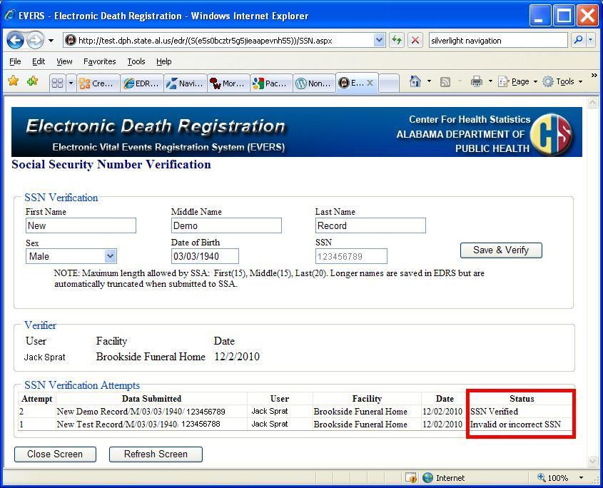
Social Security Number Verification Instructions (continued):
In the case displayed on the right, notice the first attempt to verify the Social Security Number failed due to an invalid or incorrect Social Security Number.
If the attempt fails, correct any keying errors you may have made in EDR and re-verify.
However, if the information was keyed correctly, ask the informant to verify the information is correct. If the informant provides corrected information for the deceased, enter that information in EDR and attempt to verify the SSN again.
Home
Previous
Next
Table of Contents

Slide 9
Social Security Number Verification Instructions (continued):
In the example to the right, since the first attempt to verify the Social Security Number failed, the Funeral Home corrected the entry and re-verified the record. On the second try the Social Security Number verified.
Once the record has “SSN Verified” in the status, the SSN will be locked or disabled and you cannot make changes to this field. The remaining five fields can be modified if needed. If a modification occurs you must re-verify the record through SSA before the record can be signed.
You have up to five attempts to verify a record. If after five tries the record does not verify, you CAN still file the record electronically through the EDR system.
Home
Previous
Next
Table of Contents

Slide 10
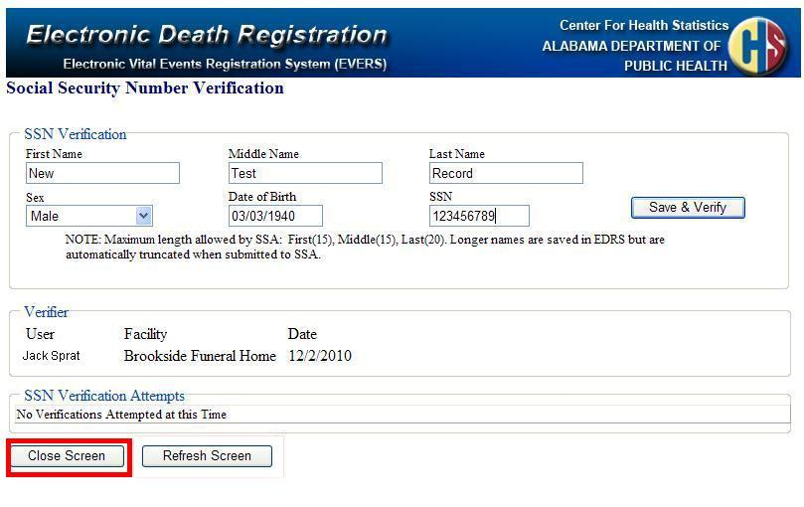
Social Security Number Verification Instructions (continued):
To close the Social Security Number Verification Page, click on the “Close Screen”.
If the record is pending a response from the Social Security Administration, you can close the Verification Page and still continue to work on the record. However, you will not be able to change the First Name, Middle Name, Last Name, Sex , Date of Birth and SSN while the record is pending even on the Deceased tab page. The rest of the record can be inserted and saved.
You can return to the Social Security Verification page to check the status later.
Home
Previous
Next
Table of Contents

Slide 11
SSN Verification Rules
There are five Required Fields: First Name, Last Name, Sex, Date of Birth, SSN
You have up to five attempts to verify a record through SSA.
If a record does not verify, you CAN SIGN AND SUBMIT the record through the Electronic Death Reporting System.
If the Social Security Number verifies, the SSN field will be locked. The remaining five fields can be modified until the record is signed.
If one or more of the six fields are modified (this includes the optional middle name), the record must be re-verified prior to signing the record.
Duplicate entries cannot be re-verified.
Home
Previous
Next
Table of Contents

Slide 12
SSN Verification Hours of Operation
Monday – Friday : 4:00 a.m. – 12:00 Midnight
Saturday: 4:00 a.m. – 10:00 p.m.
Sunday: 7:00 a.m. – 10:30 p.m.
Federal Holidays: 7:00 a.m. – 10:30 p.m.
Home
Previous
Next
Table of Contents

Slide 13
Status Descriptions
Status | Description
Name does not match SSN | The verification request passed the authorization checks, the Name did not match, and the DOB and gender were not checked. This response message will also be returned if the SSN provided belongs to another individual. User should re-check name and SSN before resubmitting. This response will also be returned if the first name supplied was only one character long.
DOB and gender do not match SSN | The verification request passed the authorization checks, the Name matched, but the DOB and gender did not.
DOB does not match SSN | The verification request passed the authorization checks, the Name and gender matched, but the DOB did not.
Gender does not match SSN | The verification request passed the authorization checks, the Name and Date of Birth matched, but the gender did not.
Invalid or incorrect SSN | The verification request passed the authorization checks, but the SSN could not be found.
Passed (Name)
SSN Verified | SSN verification was successful.
Pending (System Maintenance) | SSA is currently in scheduled downtime – Record will automatically be processed when the SSA system is back up.
Pending (System Delay) | Record be processed shortly.
Not verified--Maximum number of attempts has been reached | The maximum number of attempts (Five) has been reached.
If a record is Pending (System Maintenance) or Pending (System Delay), you may continue to work on the rest of the record while you wait for the SSA response.
Home
Previous
Next
Table of Contents

Slide 14
Frequently Asked Questions (FAQs)
Frequently Asked Questions (FAQs)
Question | Why did the end-user continue to receive a “name failure” when all verifications attempts imply the name is correct?
Answer | All identifying information must match the SSN provided. If the SSN is a valid number SSA assumes it’s correct and begins to match against the other identifying information; such as Name and Date of Birth. The SSN provided could belong to a different individual in which case the name would not match. The user should re-check the SSN as well as the name before resubmitting. Here are some helpful hints in finding the right SSN: Always take the SSN from the Social Security Card of the decedent, when possible. If the SSN provided is from SSA correspondence or the Medicare Card of the decedent, use only when A, T, TA, M or M1 follows the number. Other documents that may show the SSN of the decedent are marriage certificate, driver’s license, birth certificate of the decedent’s children, income tax statements, bank statements etc.
Question | What should the end-user do if they continue to receive a failed SSN response?
Answer | The SSN that was provided is incorrect. A failed SSN response code is returned only when the SSN provided has never been issued by SSA. Here are some helpful hints in finding the right SSN: Always take the SSN from the Social Security Card of the decedent, when possible. If the SSN provided is from SSA correspondence or the Medicare Card of the decedent, use only when A, T, TA, M or M1 follows the number. Other documents that may show the SSN of the decedent are marriage certificate, driver’s license, birth certificate of the decedent’s children, income tax statements, bank statements etc.
Question | If the correct gender code is provided, why does the end-user continue to receive a gender failure response?
Answer | If the SSA record has a gender code of “U” for (unknown), a fail SSN response code will be returned regardless of the gender code input by the user. In this situation the death certificate can still be processed through EDRS.
Question | The end-user received a response that the system is down or unavailable. When will it be available?
Answer | See Hours of Operation Page
Question | The end-user used several name variations for the same SSN and now the submission won’t process. How can the end-user get the system to process their submission?
Answer | SSA allows the end-user five chances to successfully verify an SSN. If they are unsuccessful after the fifth attempt the death certificate can still be processed through EDRS.
Home
Previous
Next
Table of Contents

Slide 15
ADPH Points of Contact
For additional questions or assistance contact the following:
Jill Brewer:
phone (334)206-2734
e-Mail: jill.brewer@adph.state.al.us
LaTarsha Shine:
phone (334)206-2754
e-Mail: latarsha.shine@adph.state.al.us
Home
Previous
Table of Contents

